Slide 1
Quinoline alkaloid
Ph Faten Essam
MSc pharmacy science

Slide 2
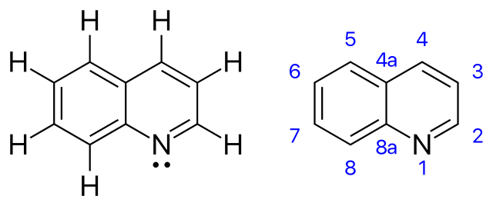
Quinolones
Is a heterocyclic aromatic compound with chemical formula C9H7N
Its slightly soluble in cold water but dissolve readily soluble in hot water and most organic solvents.
Common example of plant contain quinoline alkaloid Cinchona and Ruta

Slide 3
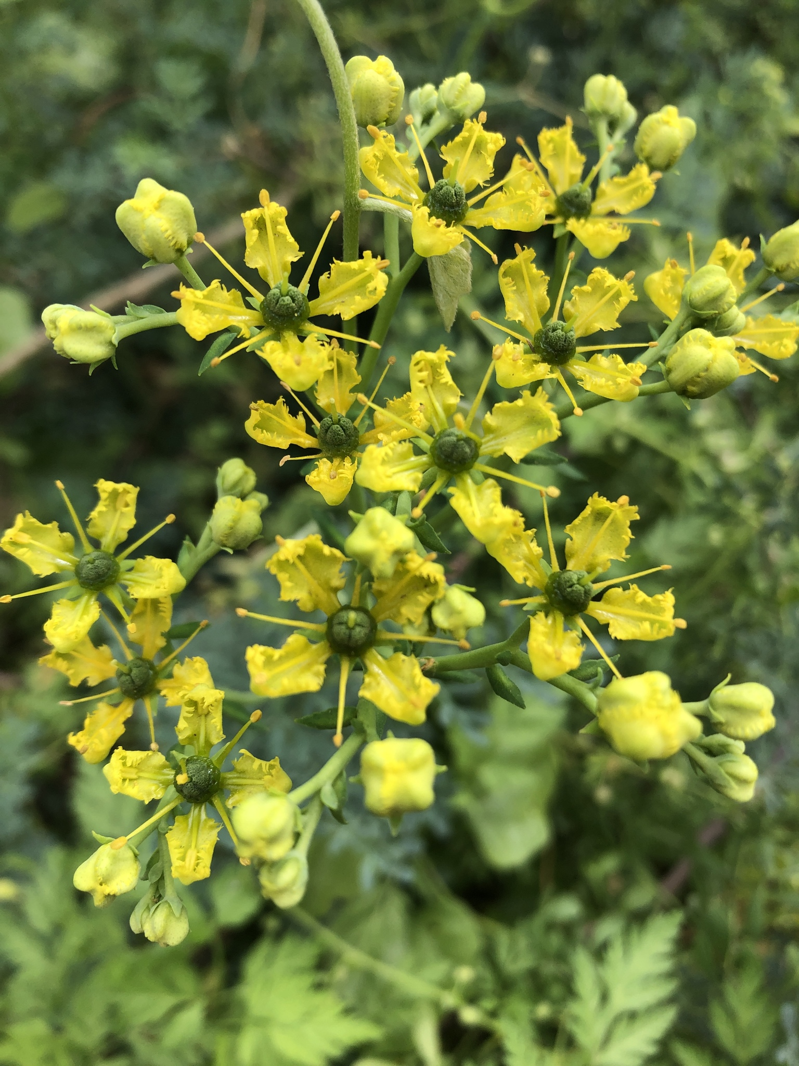
Ruta
Scientific name : Ruta graveolens
Family Rutaceae
Ruta is commonly known as Rue is a genus of ever green subshrub (20-60cm in tall ) , its grown in garden all over the world , it cultivated for its medicinal properties and insect repellent properties

Slide 4
Active constituents
Ruta contain many important active ingredient include :
Glycoside Rutin
Quinoline alkaloids
Tannins
Oils
Sterols

Slide 5
Medicinal uses of Ruta
Ruta documented therapeutic uses include the treatment of inflammatory conditions, eczema, ulcers, arthritis, fibromyalgia, antidote for venoms,
It also have (anthelmintic , antispasmodic , carminative ,emetic and expectorant ) effect

Slide 6
Caution and contraindications
Pregnant and lactating women
GIT disorder
Patient with renal disorders
Patient with liver disease

Slide 7
Plant used in this lab
Ruta graveolens
Part used whole plant

Slide 8
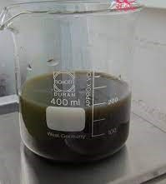
Procedure
1- add 100 ml of hexane to 10 gm of plant . (why ?)

Slide 9
2- Filter plant material 3- then use method 2 of alkaloid isolation which include : a. To the marc add 100 ml of dilute acidified alcohol and mix for 10 min. b. Filter the plant material and collect the extract

Slide 10
c- Take 5 ml of extract in s. p and add 5 ml of chloroform to it then shake well and let stand d-Now take the aq layer and add sodium bicarbonate ????

Slide 11
e-Add 5 ml of chloroform to the mixture and collect the organic layer

Slide 12
Now you get alkaloid as…………….????

Slide 13
Detections
Wagner's test
Potassium permanganate + extract
1-reagent color (purple) disappear
2- brown precipitate will form

